Slide 1
IHRM
Ivoyant HR
Dashboard
Project
Resource
Timesheet
Leave Management
Leave encashment calculation
Attendance Reminder
Yearly Leave Plan
Notification
Asset
Email Template
Allocate Resources (play ground)
General storage to Hr policies etc.
Certification & approval
Post articles, Buzz
Learning
OnBoarding
Post vacancy ( ihrm to linkedin )
Resignation
2FA forgot password
Corporate branding
Module Configuration
Performance Appraisal

Slide 2
IHRM
Manager DashBoard
Total project count
Resources count
Notification count
On leave count
Update Profile
Change Password
View Notification
Pending approvals

Slide 3
IHRM
User DashBoard
Total my project count
Leave Details
Update Profile
Change Password
View Notification

Slide 4
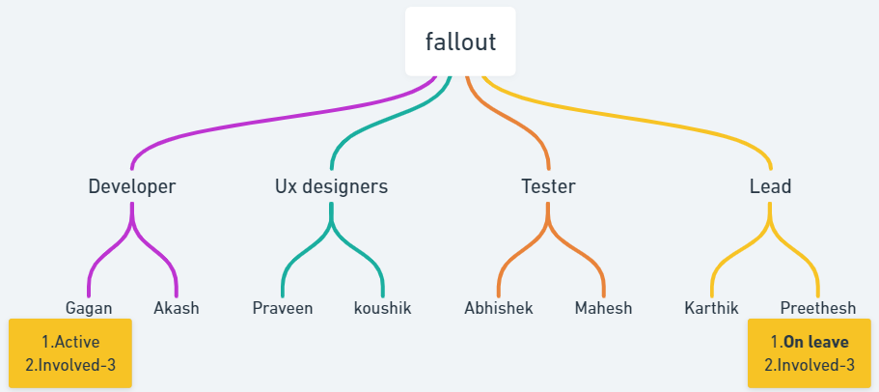
IHRM
Manager Projects
Note 1.Add priority for each task
List of projects
On click individual project
Tree structure
Table view

Slide 5
IHRM
User Projects
List of my projects
On click individual project
Tree structure
Table view
Involved in projects are not required for user

Slide 6
IHRM
Manager Resource
List of Resources
On click Resource Details

Slide 7
IHRM
Manager TimeSheet
List of service teams
On click service team details

Slide 8
IHRM
User TimeSheet
Update Resource timesheet

Slide 9
IHRM
Manager Leave Management
Approve leave/Reject leave
View Leave Balances
Team CalendarLeave
Bulk Actions[approval or rejection]
Leave History
Leave Reports
Leave Policies

Slide 10
IHRM
User Leave Management
Leave Request Submission
Leave Approval Workflow
Leave Balance Tracking
Calendar View
Leave History
Flexible Leave Policies
Notifications and Reminders
Document Upload
Leave Forecasting
Reporting and Analytics

Slide 11
IHRM
Manager Leave Balance Settlement
Dashboard Overview
Leave Approval
Leave Adjustment
Leave Reports.
Leave Settlement
Integration with HR Systems
Notifications and Reminders
Legal Compliance
Employee Self-Service

Slide 12
IHRM
User Leave Balance Settlement
Leave Balance Viewing
Leave Request Submission
Leave Approval Workflow
Leave Calendar
Leave Policy Information
Leave Balance History
Leave Balance Projections
Mobile Accessibility
Self-Service Features
Integration with HR Systems

Slide 13
IHRM
User Attendence Remainder
Attendance Reports
Customizable Reminders
Reminder Notifications
Attendance Tracking

Slide 14
IHRM
Manager Yearly Leave Plan
Leave Request Management
Calendar View
Leave Balances Tracking
Customizable Leave Policies
Automated Notifications
Integration with HR Systems
Reporting and Analytics.
Multi-level Approval Workflow
Mobile Accessibility
Employee Self-Service Portal

Slide 15
IHRM
User Yearly Leave Plan
Leave Request Submission
Leave Type Selection
Calendar View
Leave Balance Tracking
Approval Workflow
Notifications
Leave History
Auto-Accrual
Blackout Dates
Partial Day Leave
Attachments.
Customization
Public Holidays.
Time Zone Support

Slide 16
IHRM
Manager Notification
User Management
Notification Creation
Notification Templates
Scheduling
Priority Levels
Delivery Options
Recipient Groups
Read Receipts
Analytics and Reporting
Integration with Other Tools
Customization
Permission Controls
Feedback Mechanism
Archiving and Search
Security Measures

Slide 17
IHRM
User Notification
User Registration and Authentication
Notification Preferences
Customizable Notifications.
Real-time Notifications
Notification History
Multi-channel Support
Segmentation and Targeting
Scheduled Notifications
Two-way Communication
Localization and Internationalization
Notification Templates
Opt-out Mechanism
Notification Analytics
Notification Prioritization
Permission Management
Notification Scheduling
Cross-platform Compatibility

Slide 18
IHRM
Manager Assets
Asset Tracking
Maintenance Scheduling
Depreciation Tracking
Inventory Management
Asset Lifecycle Management
Compliance Management
Integration
Mobile Access
Reporting and Analytics
Asset Auditing
Security
Customization
Predictive Maintenance
Vendor Management
Scalability

Slide 19
IHRM
User Assets
User Authentication
User Profile Management
Authorization and Permissions
Content Creation and Management
Social Interactions
Search and Filtering
Analytics and Insights
Payment Processing
Data Security and Privacy
Feedback and Support
Localization and Internationalization
Integration with Third-Party Services
Customization and Personalization
Accessibility
Scalability and Performance

Slide 20
IHRM
Manager Email Template
Customization Options:
Clear Subject Line
Introduction
Body Content
Bullet Points or Numbered Lists
Action Items
Call to Action
Closing
Attachments
Signature
Feedback Mechanism
Formatting and Styling
Mobile Optimization
Approval Process

Slide 21
IHRM
User Email Template
Loan proof request
Address proof request
All doc request

Slide 22
IHRM
Manager Resource Allocate
Reporting and Analytics
Skill Matching
Communication Tools
Time Tracking

